Slide 1
Heavy rainfall in Central Vietnam based on observation:
Case studies
Thang Vu, Kim Nguyen and Thang Nguyen
9-15th December 2012
Melbourne

Slide 2
Contents
Data
Methodology
Primarily Results
Conclusions

Slide 3
1. Data
APHRODITE rainfall data
Local observation
Reanalysis data NCEP-R2
Cold front data
Tropical cyclones from UNISYS

Slide 4
2. Methodology
1) Area average over region (106-110⁰E, 12-19⁰ N) APHRODITE daily rainfall (1979-2001)
2) Sort this time series in ascending order and took top 1%
3) Based on step 2 and synoptic charts, determine which days that heavy rainfall caused by:
Tropical cyclone (TC), ITCZ
Cold Front (CF), CF+ easterly wind aloft (CF+EW)
CF+ TC and ITCZ
4) Composites of meteorological variables based on step 3 (not yet to be done)

Slide 5
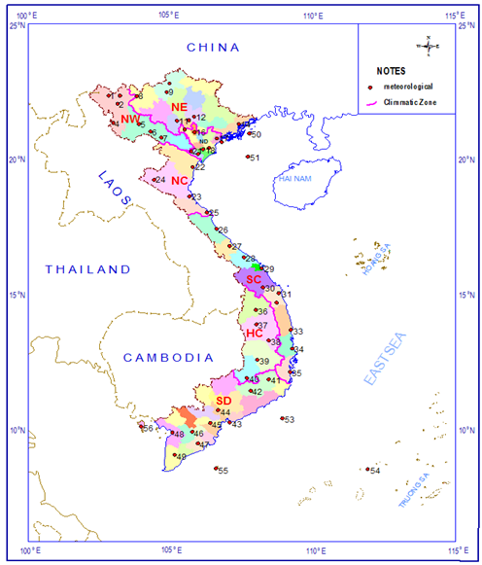
3. Primarily Results
MAY TO NOV
THANH HOA
AUG to DEC
HUE
AUG to DEC
THATRANG
Notes:
Overview climate in central VN

Slide 6
3. Primarily Results
Heavy rainfall occurs from May to Dec
but peak occurs from Oct to Nov and contributed around 65% to day total of the heavy rainfall

Slide 7
3. Primarily Results
CASE STUDIES OF HEAVY RAINFALL CAUSED BY TC, CF&EW AND CF+TC
Case 1: Tropical cyclone (TC) on 27th Jun 1992
Case 2: Combination of Cold front and easterly wind aloft (CF+EW) on 22th Oct 1991
Case 3: Combination of Cold front and TC on 22th Oct 1986
We will investigate
Rainfall
Geopotential height and wind at 1000, 850, 700 and 500 hPa
Surface pressure,…

Slide 8
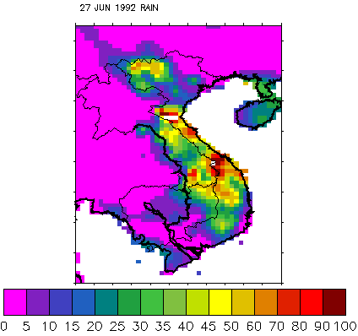
Case 1: Heavy rainfall on 27th-Jun-1992 caused by Tropical cyclone (category 4)
mm/day

Slide 9
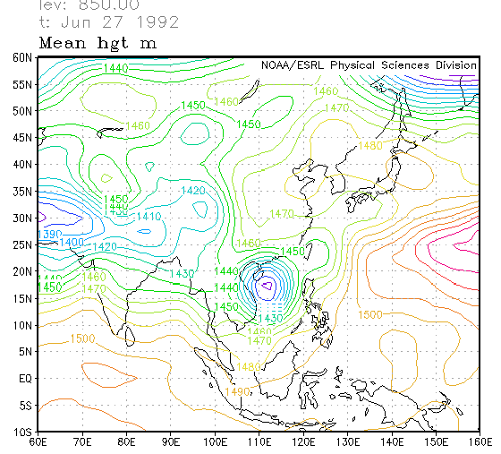
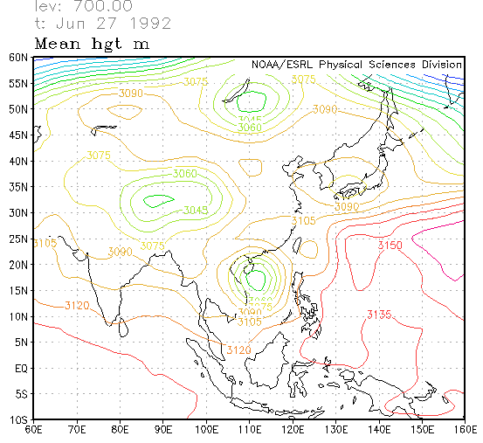
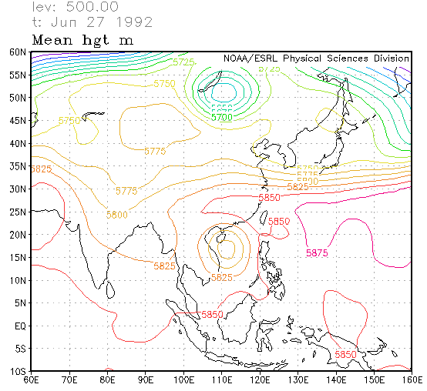
Case 1: Geopotential Height on 27th-Jun-1992 caused by TC
850 hPa
700 hPa
TC
TCs
TC
500 hPa
A strong TC indicated by steep gradient at 850 and extension up to 500hPa
TC
TCs

Slide 10
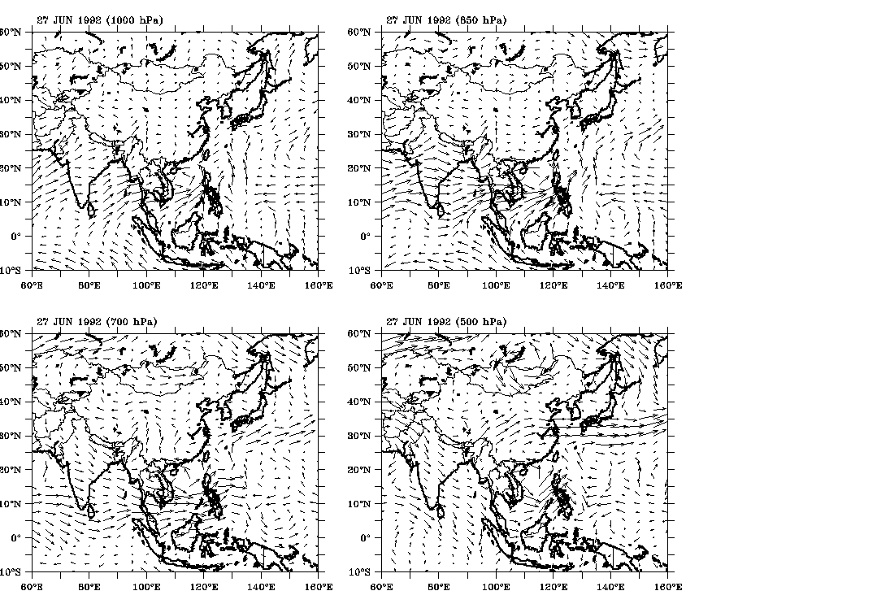
CASE 1: Wind at 1000, 850, 700 and 500 hPa
on 27th-JUN-1992 caused by TC
1000 hPa
850 hPa
TC
TC
700 hPa
500 hPa
TC
TC

Slide 11
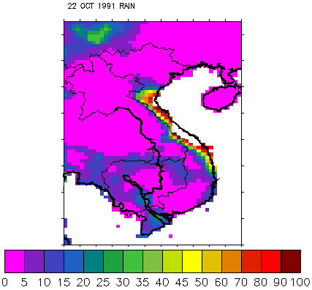
Case 2: Heavy rainfall on 22th-Oct-1991 caused by combination of CF and EW
mm/day

Slide 12
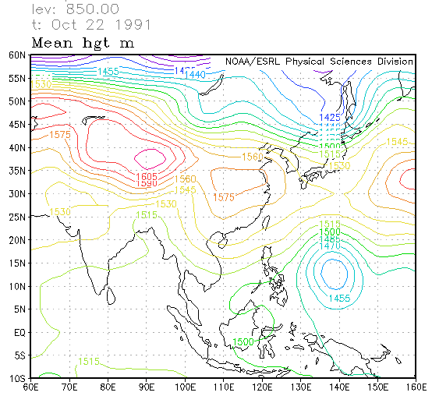
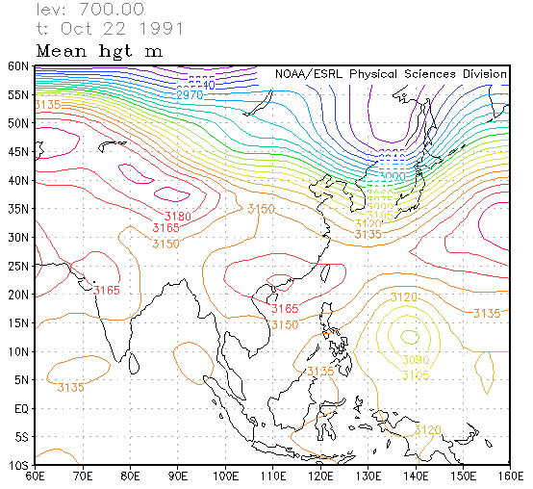
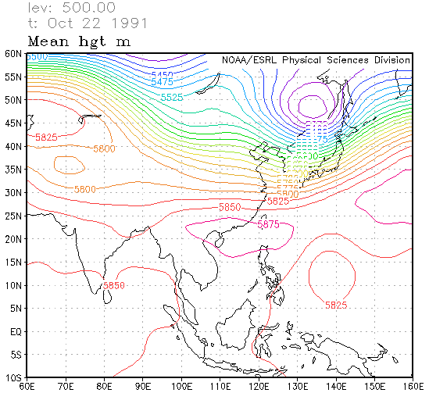
Case 2: Geopotential Height on 22th-Oct-1991 caused by combination of CF and EW
850 hPa
700 hPa
H
H
+ At 850 hPa, Siberian high pressure intensified and extend to Central Vietnam => NE wind prevailing this area.
+ At 700 and 500 hPa Pacific - subtropical high pressure cover North Vietnam => Aloft easterly wind prevailing over central Vietnam.
500 hPa
H

Slide 13
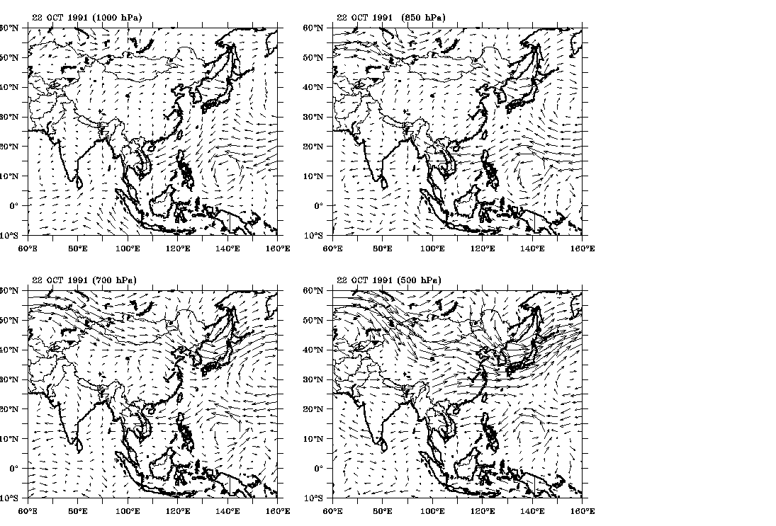
Case 2: Wind at 1000, 850, 700 and 500 hPa on 22th-Oct-1991 caused by combination CF and EW
1000 hPa
850 hPa
NE wind
NE wind
700 hPa
500 hPa
EW aloft
EW aloft

Slide 14
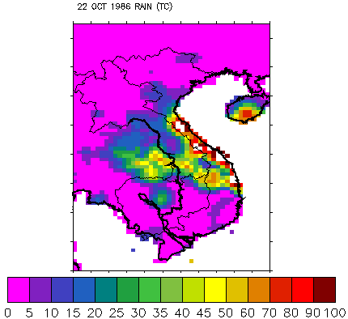
Case 3: Heavy rainfall on 22th-Oct-1986 caused by combination of CF and TC
mm/day

Slide 15
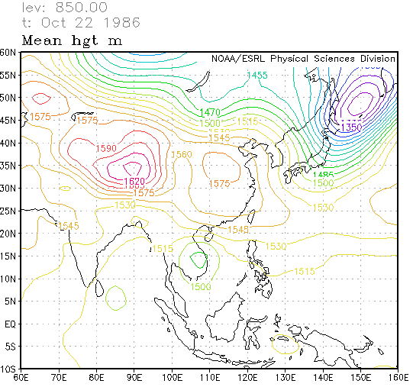
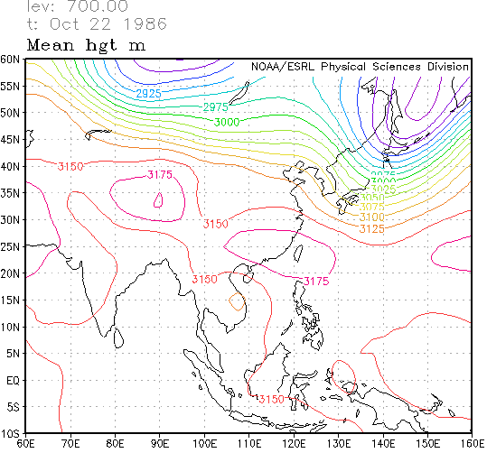
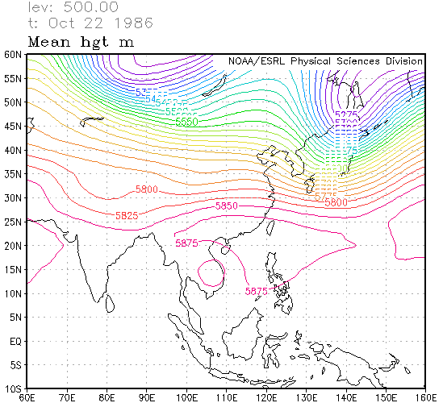
Case 3: Geopotential Height on 22th-Oct-1986 caused by combination of CF and TC
850 hPa
700 hPa
H
TC
TC landfall
500 hPa
At 850 hPa, Siberian high pressure intensified and extended to North Vietnam. While a tropical cyclone landfall over Central Vietnam.
At 700 and 500 hPa, TC signal is weaker

Slide 16
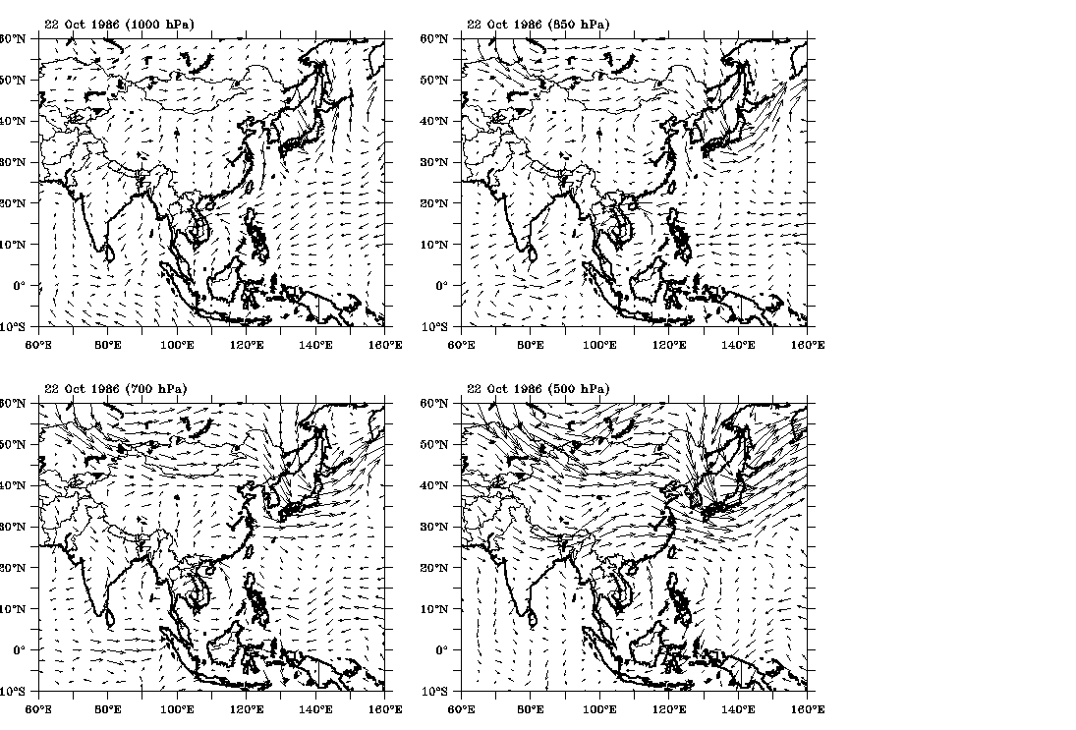
Case 3: Wind at 1000, 850, 700 and 500 hPa on 22th-Oct-1986 caused by combination of CF and TC
1000 hPa
850 hPa
NE wind
NE wind
TC
TC
700 hPa
500 hPa
TC
TC

Slide 17
4. Conclusions
1) Heavy rainfall days in Central Vietnam occurred mostly from Sep to Nov, maximum is in Oct (42%).
2) Heavy rainfall in Central Vietnam contributed by components:
- 52 % by TC, ITCZ
- 28 % by Cold fronts and TC/ ITCZ combined
- 17 % by CF and easterly wind aloft combined
- 3% by others (not yet investigated)
52%

Slide 18
Future plan
We plan to publish this work
Use this knowledge to investigate CCAM simulation results for the current and future climate.

Slide 19
Thank you for your attention!

Slide 20
1. Overview
Studies on heavy rainfall in Central Vietnam
1) Yokoi and matsumoto, 2008. Cold surge and tropical depression disturbance is important for occurence of heavy precipitation in central Vietnam.
2) Yen, M-C, and Coauthors, 2011. Interannual variation of the fall rainfall in Central Vietnam closely correlation with the SST (Nino 3.4) index.
3) Chen, T-C, and coauthors, 2012.
- 62% of the total rainfall in Central Vietnam during Oct-Nov is contributed by Heavy rainfall/Flood and only 33% by a cold surge vortex and tropical cyclone combined.
- The rainfall maximum in central Vietnam during late fall:
+ Increase to 174%, when ∆SST (Nino 3.4) index ≤ -0.5
+ Reduction to 52%, when ∆SST (Nino 3.4) index ≥ 0.5

Slide 21
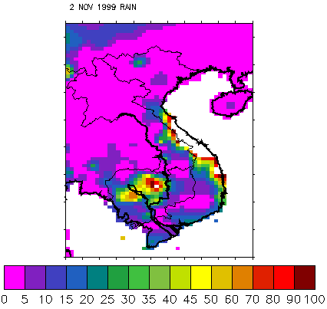
Case 4: Heavy rainfall amount on the 2-Nov-1999 due to combination of CF and ITCZ

Slide 22
Case 4: Geopotential Height on the 2-Nov-1999 caused by CF and ITCZ
850 hPa
700 hPa
H
On 850 hPa, Siberi high pressure extend to Central Vietnam
NE monsoon
On 700 hPa, Pacific ocean subtropical high pressure extend to Central Vietnam
500 hPa

Slide 23
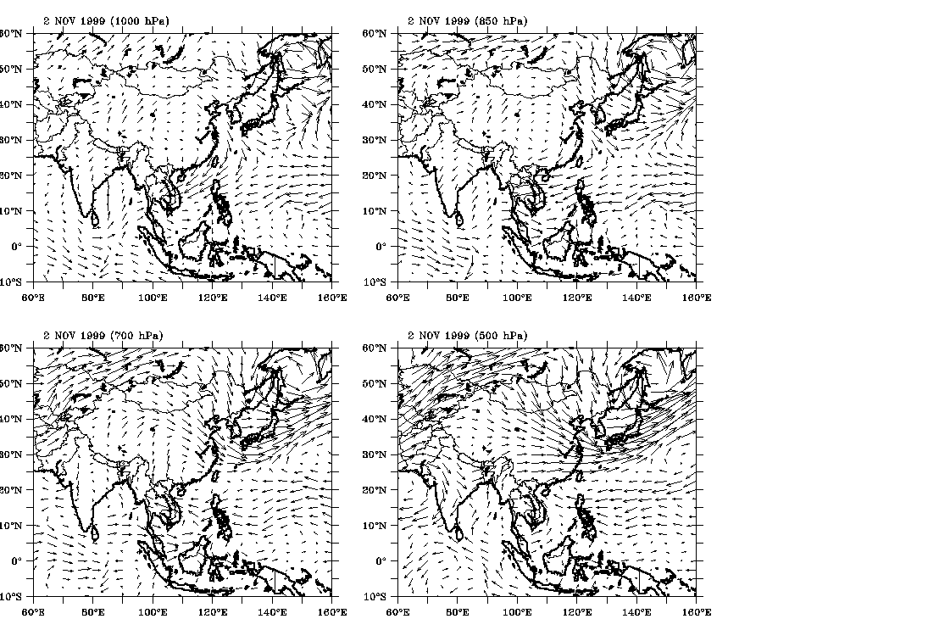
Case 4: Wind at 1000, 850, 700 and 500 hPa on the 2-Nov-1999 bcaused by CF and ITCZ
On 850 hPa, NE trade
NE wind
NE Trade
ITCZ

Slide 24
Overview
Yokoi and matsumoto, 2008. Collaborative effects of cold surge and tropical depression-type disturbance on heavy rainfall in central vietnam.
Cold surge and tropical depression disturbance is important for occurence of heavy precipitation in central Vietnam
2) Yen, M-C, and Coauthors, 2011. Interannual variation of the Fall rainfall in central Vietnam.
Interannual variation of the fall rainfall in Central Vietnam closely correlation with the SST (Nino 3.4) index.

Slide 25
Overview
3) Chen, T-C, and coauthors, 2012. interannual variation of the late fall rainfall in Central Vietnam.
62% of the total rainfall in Central Vietnam during Oct-Nov is contributed by the HRF and only 33% by a cold surge vortex and tropical cyclone combined.
The rainfall maximum in central Vietnam during late fall:
+ Increase to 174%, when ∆SST (Nino 3.4) index ≤ -0.5
+ Reduction to 52%, when ∆SST (Nino 3.4) index ≥ 0.5

